Slide 1
Our RE topic- Revelation

Slide 2
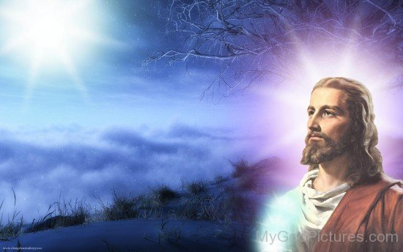
God reveals Himself through Jesus Christ, the Church, Creation and the Scriptures
EYFS
Learn that we are all special in different ways.
Understand the role of Jesus as a special person
Explore how the example of Jesus helps us to live

Slide 3
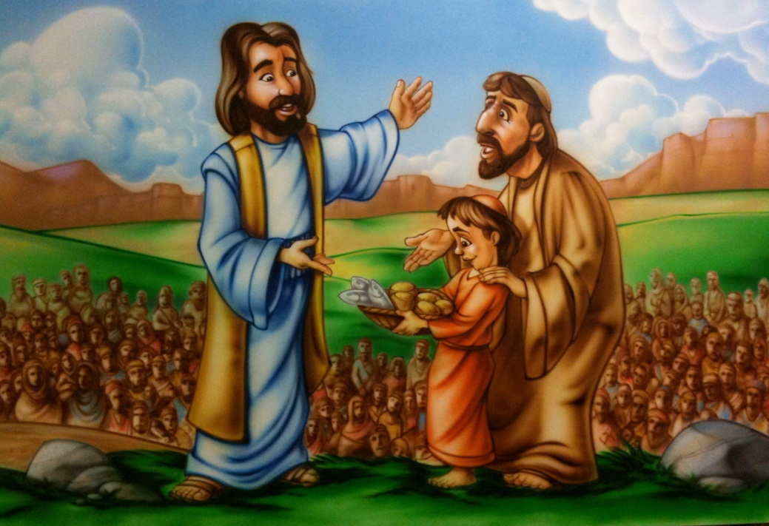
God reveals Himself through Jesus Christ, the Church, Creation and the Scriptures
Year One
Explore stories that show how special Jesus is
The Good Samaritan reveals what God’s love is like
Miracle stories show how important Jesus is

Slide 4
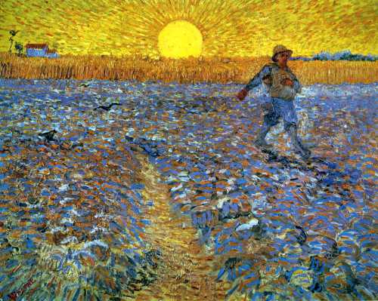
God reveals Himself through Jesus Christ, the Church, Creation and the Scriptures
Year Two
Become aware of the specialness of Jesus
Explore how miracle stories show that the Kingdom of God is present within Jesus
Explore parables and some of the meanings behind them

Slide 5
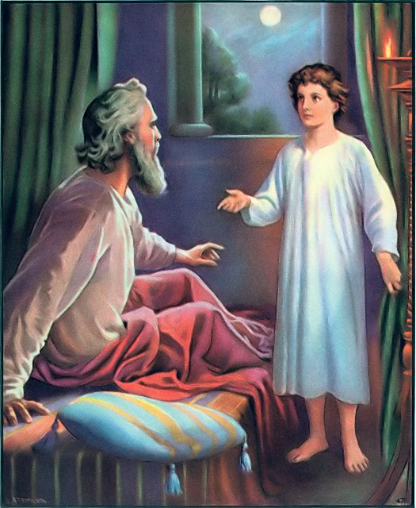
God reveals Himself through Jesus Christ, the Church, Creation and the Scriptures
Year Three
Explore the response of Samuel to God’s plan
Explore what the Liturgy of the Word is, and our response to it
Explore how people recognised God’s revelation of Himself at The Presentation of Jesus and the Baptism of Jesus

Slide 6
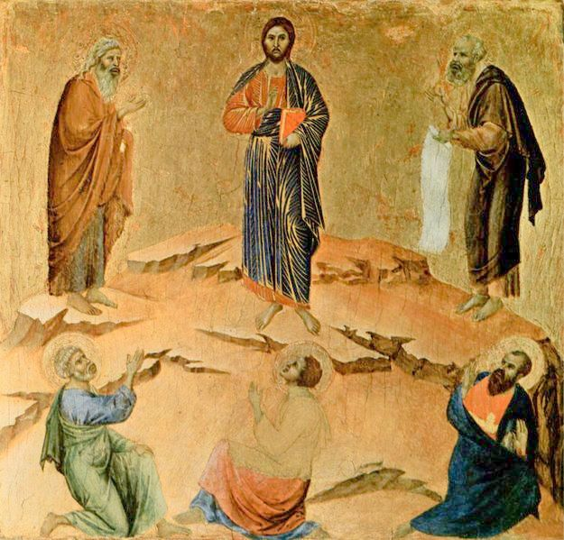
God reveals Himself through Jesus Christ, the Church, Creation and the Scriptures
Year Four
Explore how the revelation of God is recognised by Simeon and Anna, at the Presentation of Jesus
Explore how the disciples responded at the Transfiguration of Jesus
The symbolism of light is explored

Slide 7
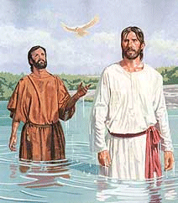
God reveals Himself through Jesus Christ, the Church, Creation and the Scriptures
Year Five
Explore God’s revelation of Himself in Jesus, through John the Baptist
The importance of Baptism
Explore how parables help us to understand, and teach us about, the Kingdom of God

Slide 8
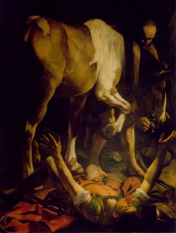
God reveals Himself through Jesus Christ, the Church, Creation and the Scriptures
Year Six
Examine the impact of the conversion of St. Paul on himself, those around him and the Church
Reflect on the deep and personal relationship that St. Paul enjoyed with Jesus
What might we learn from St. Paul?

